Slide 1
Figure 18.1

Slide 2
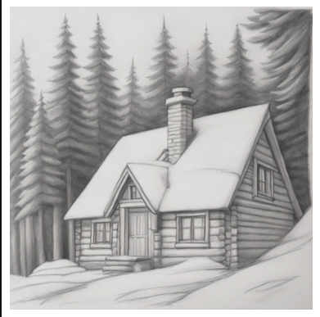
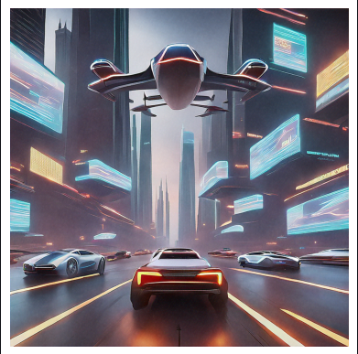
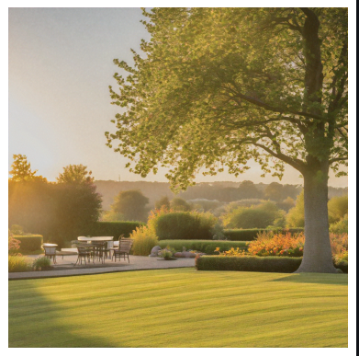
Prompt: A pencil sketch of a cozy cottage with a chimney, nestled in a snowy forest, detailed with shading to create depth.
Prompt: A digital artwork of a futuristic city with flying cars zipping past towering skyscrapers, illuminated by glowing holographic billboards.
Prompt: Golden hour lighting illuminating a tranquil garden. Negative Prompt: A dark, dimly lit garden with harsh shadows, lacking the warmth of golden hour lighting.
Generative AI app powered by Image Model

Slide 3
Notebook Image

Slide 4
length = 3 m
breadth = 2 m

